Slide 1

GROUP ASSIGNMENT 02: WORLD HEALTH
GROUP E
FAHAD ALSALEH MAZEN AL-HABIB FATIMAH ALALI
FAHAD ALFASSAM AHMED ALMUTAWA MATTER ALOTAIBI
DURRAH ALZAMIL OTHMAN OTAIBI

Slide 2
Data Set at a Glance
Lists countries and indicators of their safety, health, pollution, etc.
Data recorded at different points in time, non-uniform across indicators.

Slide 3
Issues with Data Set
Unavailable data
Gaps in data collection over the years
Discrepancies in country names across indicators (due to political events)

Slide 4
Data Preprocessing
Combined all files into
One file with multiple sheets
A single sheet
Performed PCA
Converted text into numerical values
Added Country-Continent table to map indicators to continents

Slide 5

TOBACCO USE
I wasn’t able to draw a conclusion or a story behind this plot. Below is my attempt:
* The majority of countries or even continents had an enhancement throughout the years from 2000 to 2018. The color shifts from light green (middle point of the legend) to darker green) as well as reduction in red (high percentage of tobacco consumption).

Slide 6
TOP 10 COUNTRIES ON MEDICAL DOCTORS
In the first few years, Italy was leading at the top with more then 59 doctors available per 10,000 from the population. In year, 2000, Italy started dropping drastically and Cuba took the lead reaching more than 84 doctors per 10,000 of population by the year 2018.
Missing the legend color

Slide 7
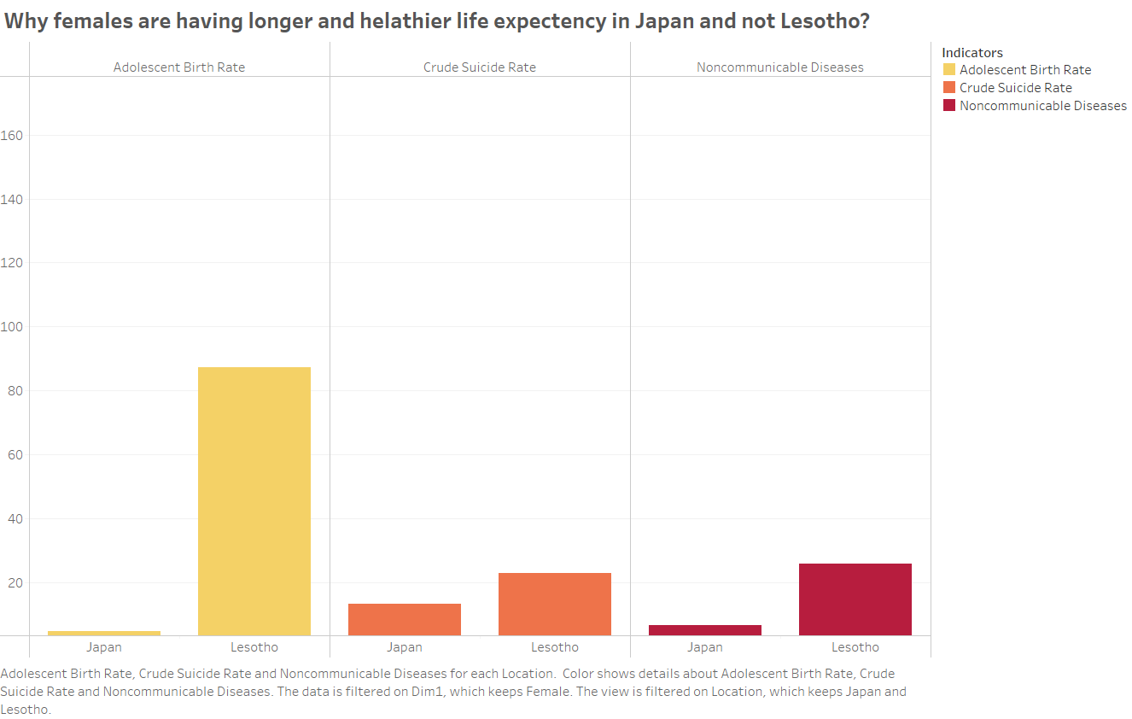
LIFE EXPECTANCY AT BIRTH FOR FEMALES. WHY?
This plot shows that females in Lesotho between the age of 15-19 years give birth at a much higher rate when compared to Japan. (Adolesent Birth Rate is the annual number of births to 15-19 years of age per 1,000 females in that age group).
Crude suicide rate is the number of deaths in a year divided by the population and multiplied by 100,000 (per 100,000 population). Lesotho has much higher rates as well in suicide when compared to Japan.
NCD are non-infectious and non-transmissible among people. Lesotho has much more NCDs than Japan.
NOTE: The lowest country is Central African Republic, not Lesotho as illustrated in the previous slide. I recommend replacing Lesotho with Central African Republic.

Slide 8
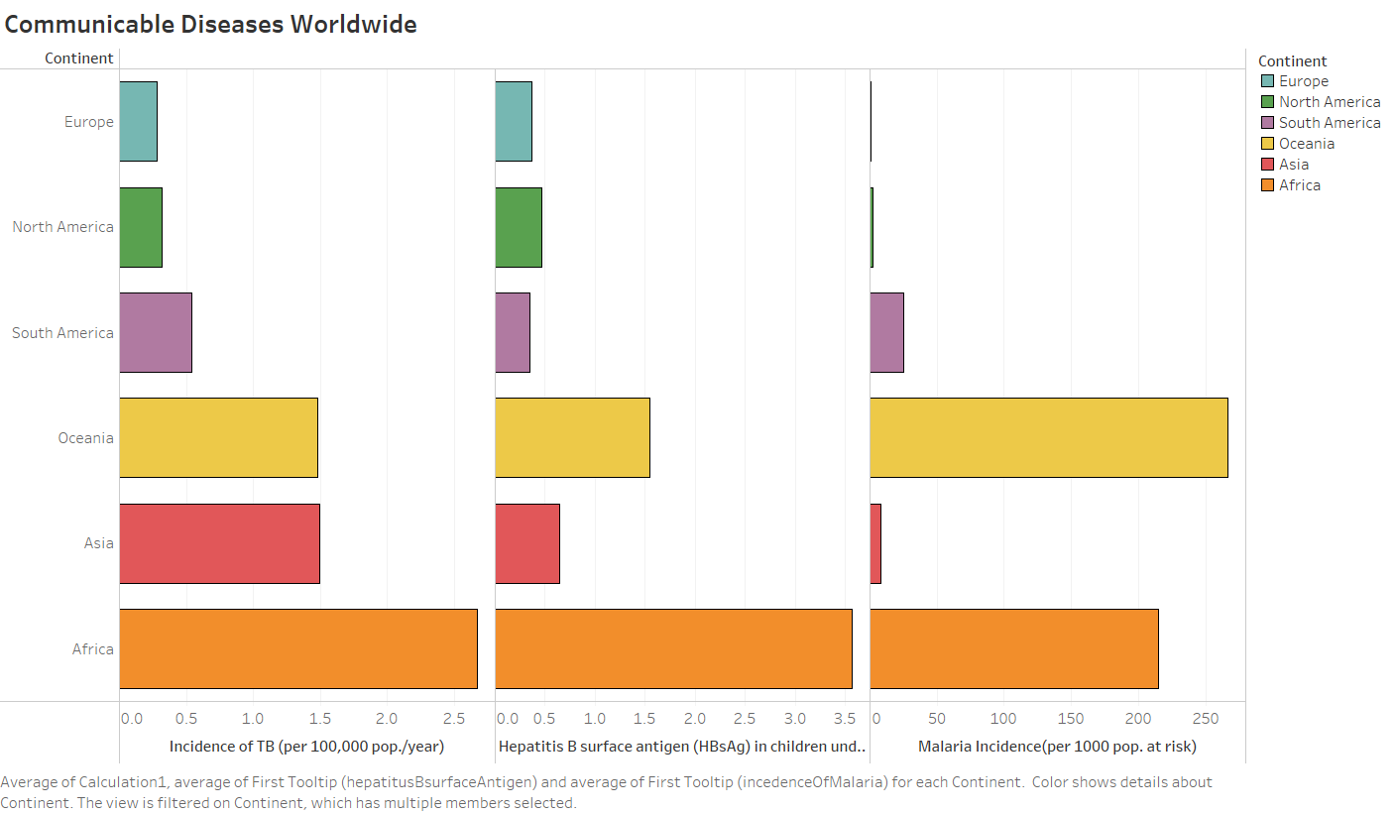

Slide 9
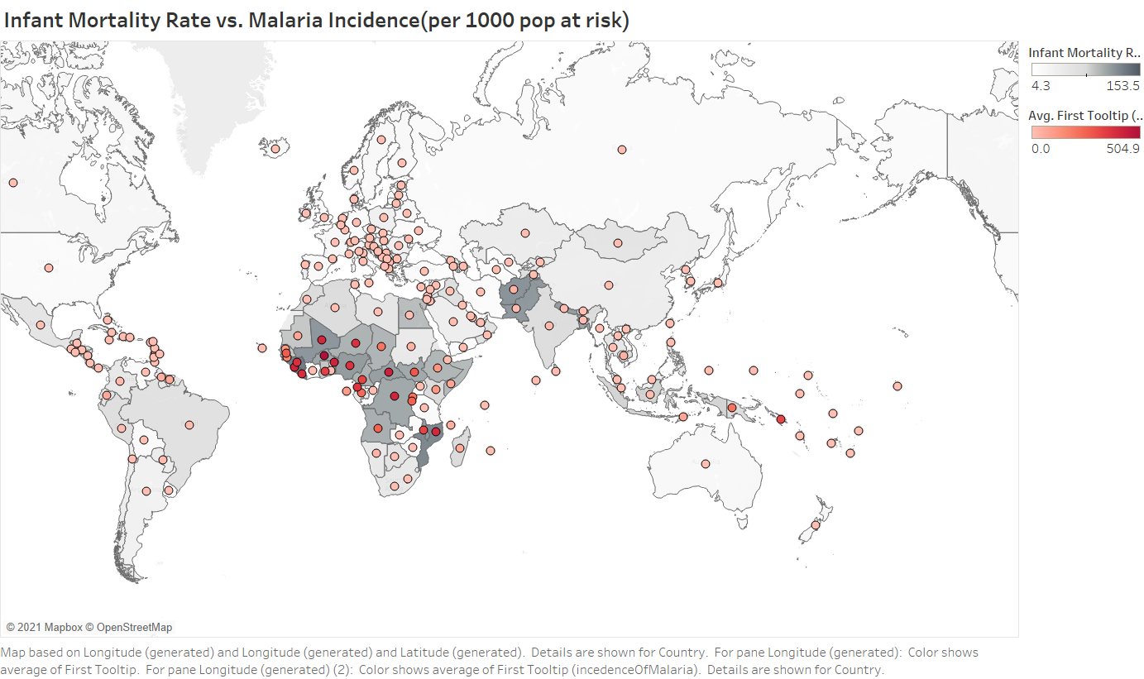

Slide 10
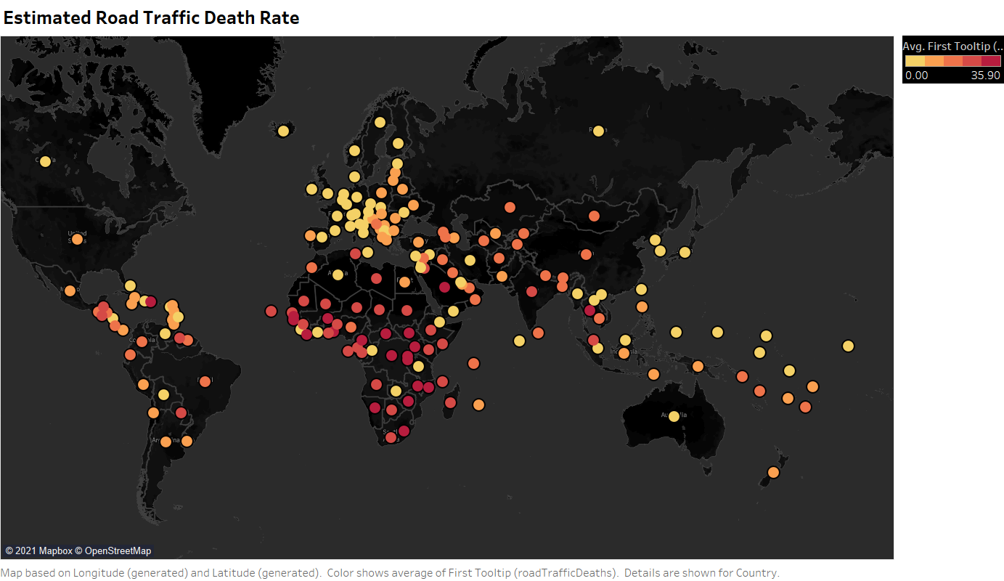

Slide 11
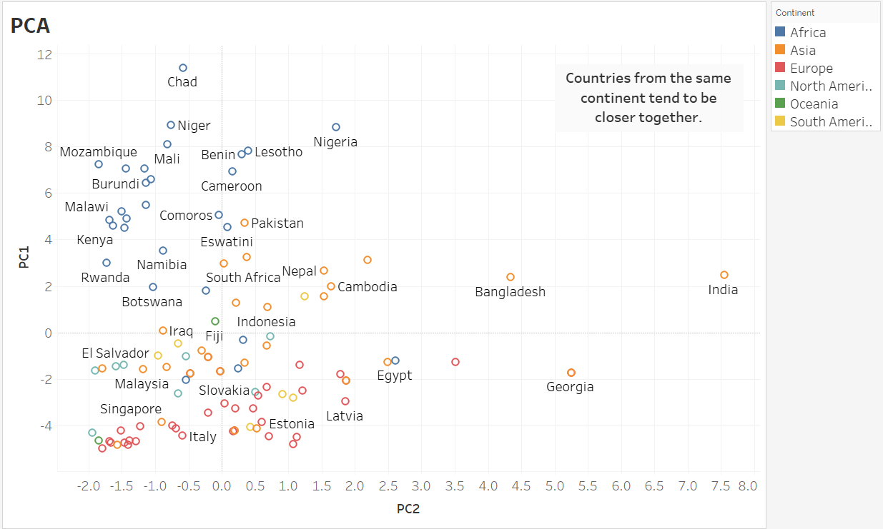

Slide 12
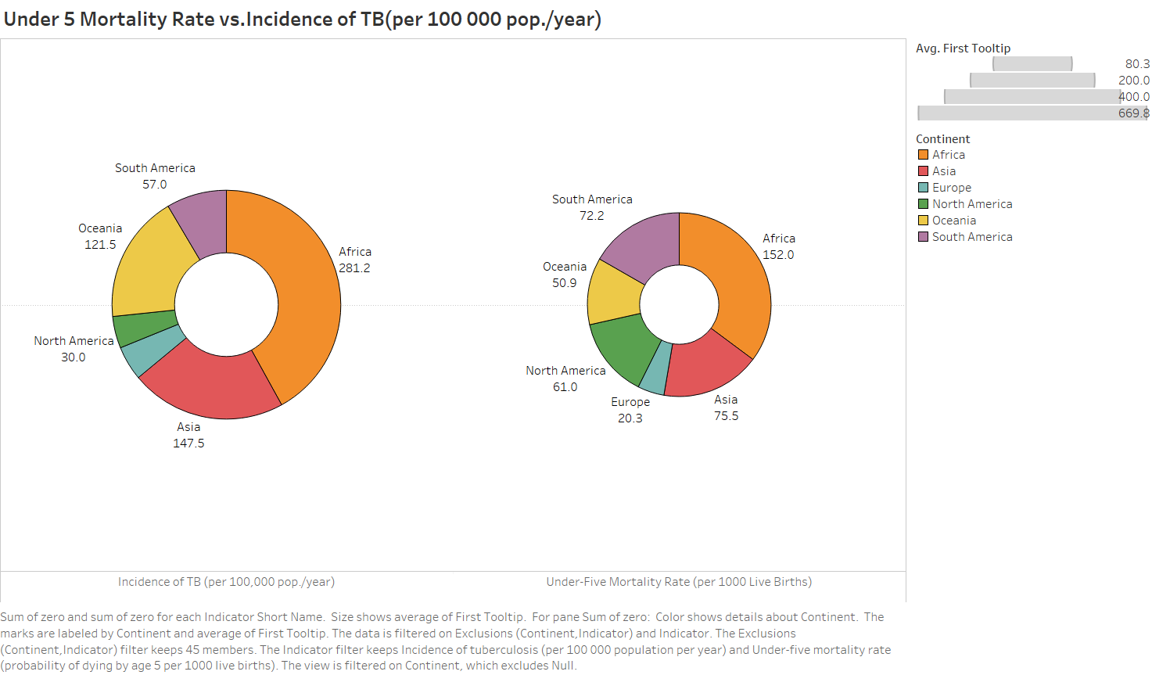

Slide 13
Global Overview

Slide 14
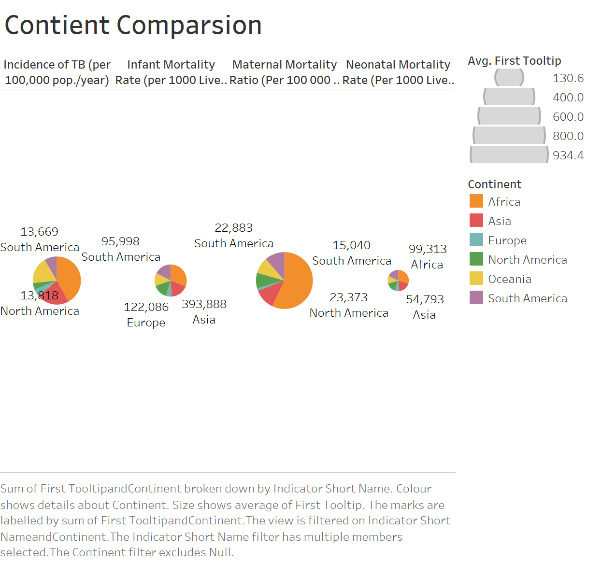

Slide 15
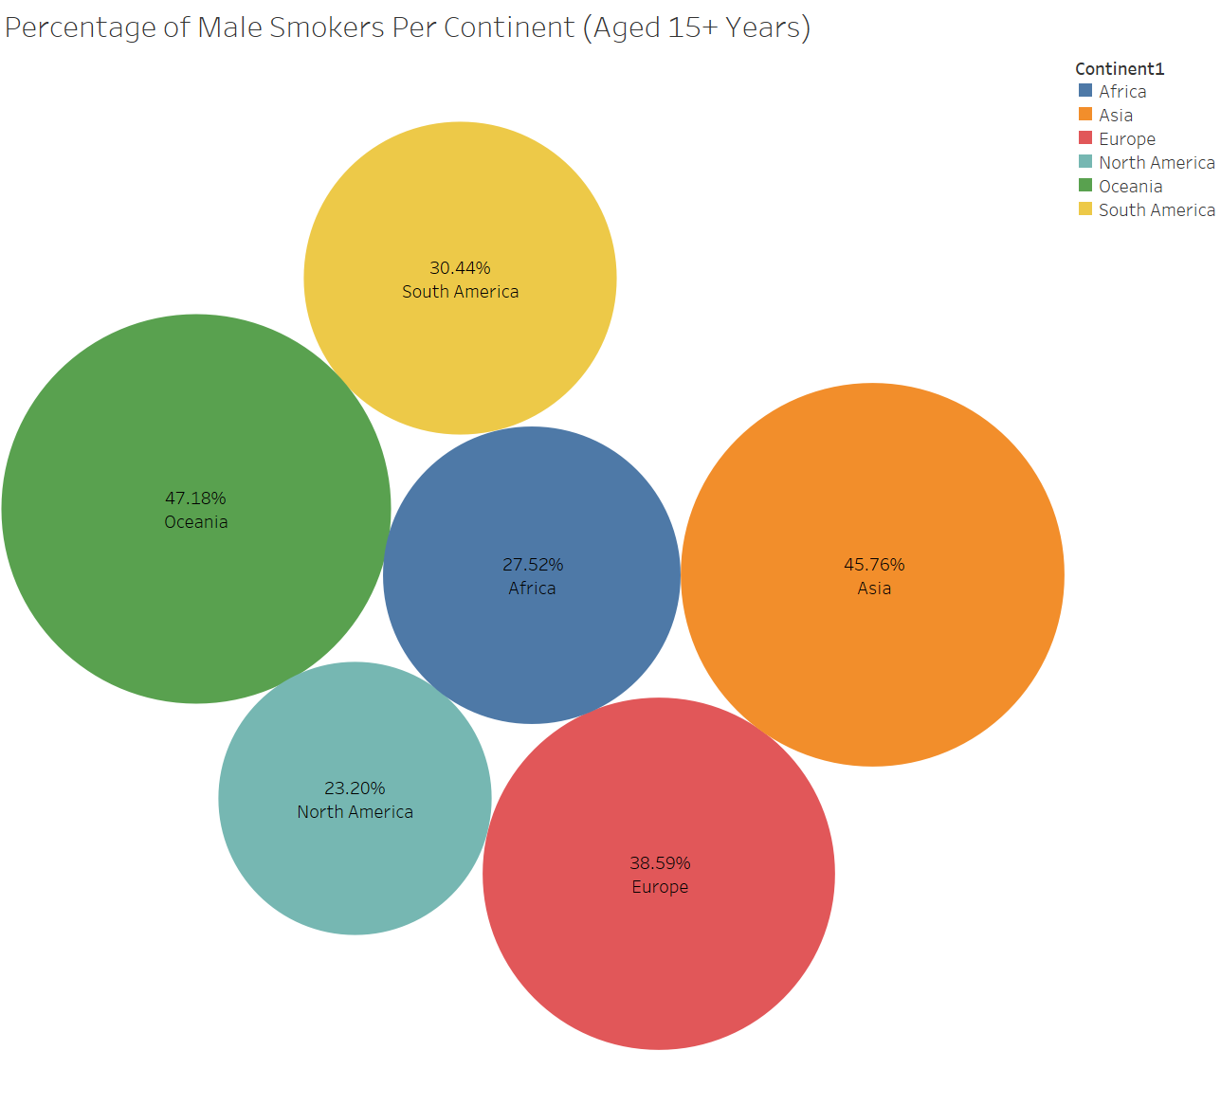

Slide 16
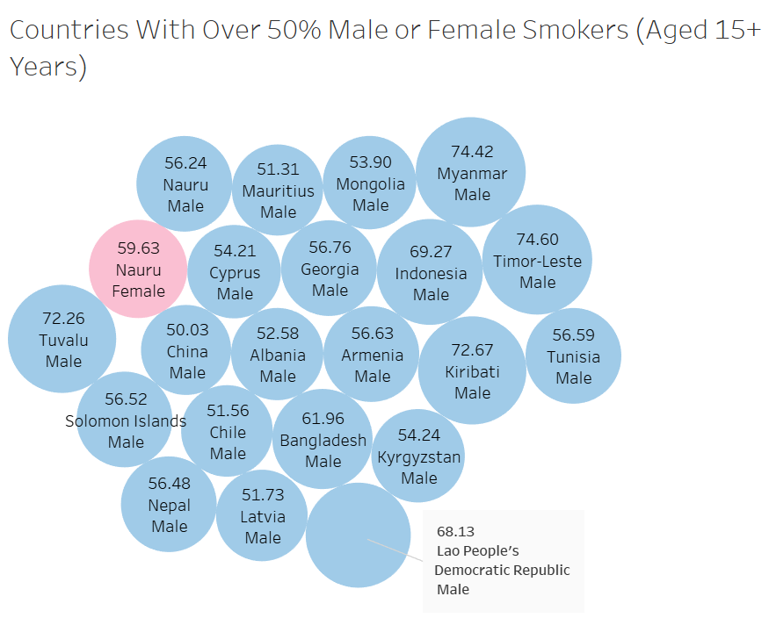

Slide 17
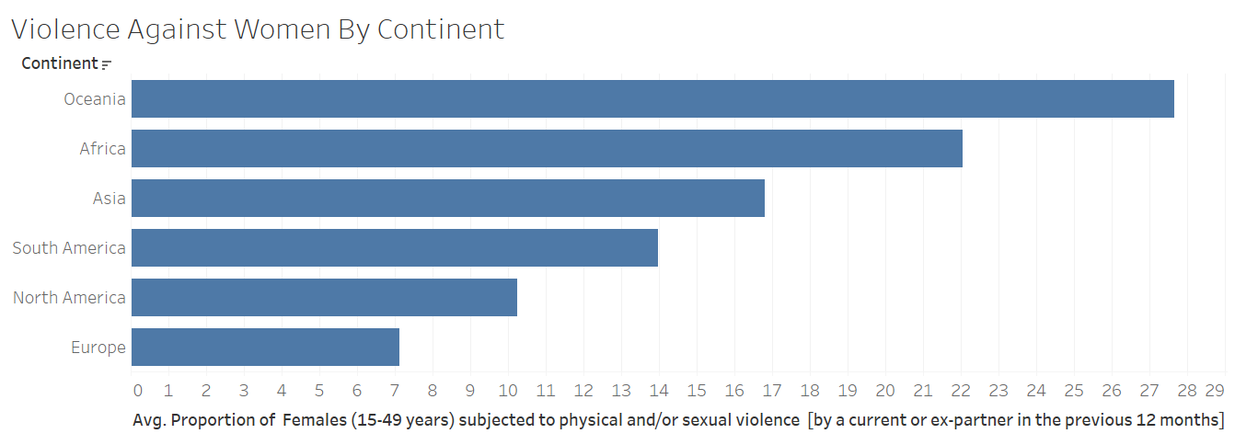

Slide 18
A Closer Look

Slide 19
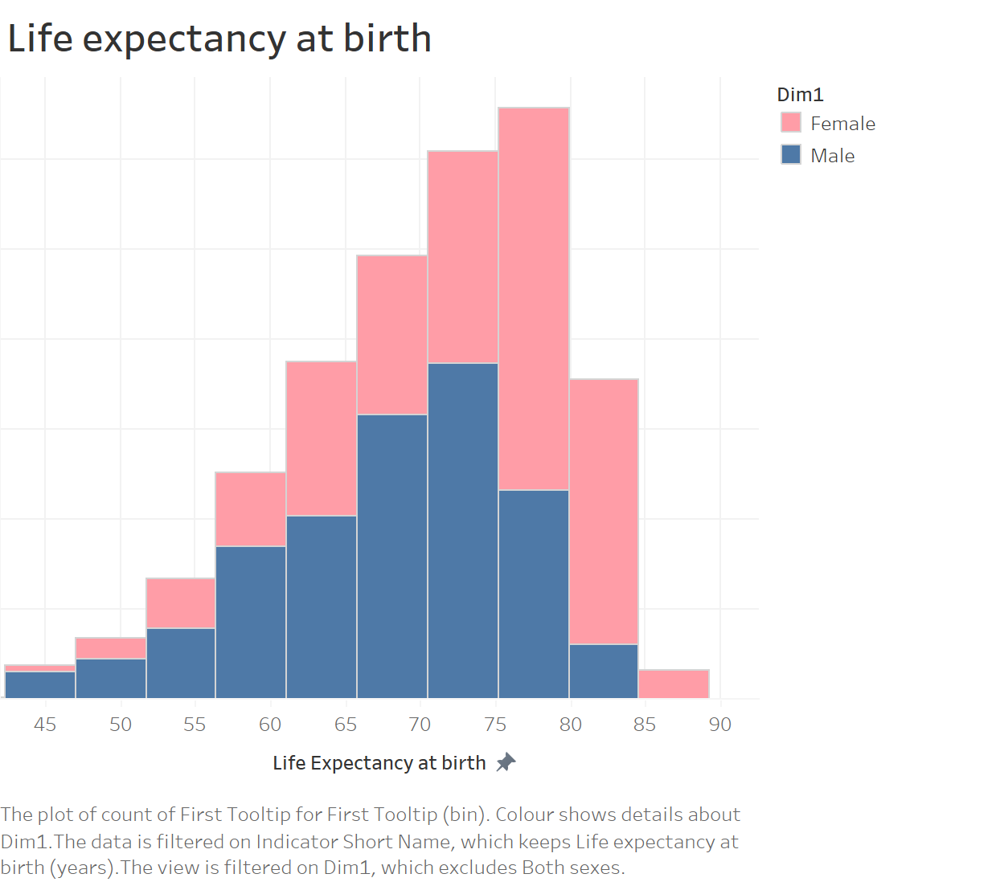

Slide 20
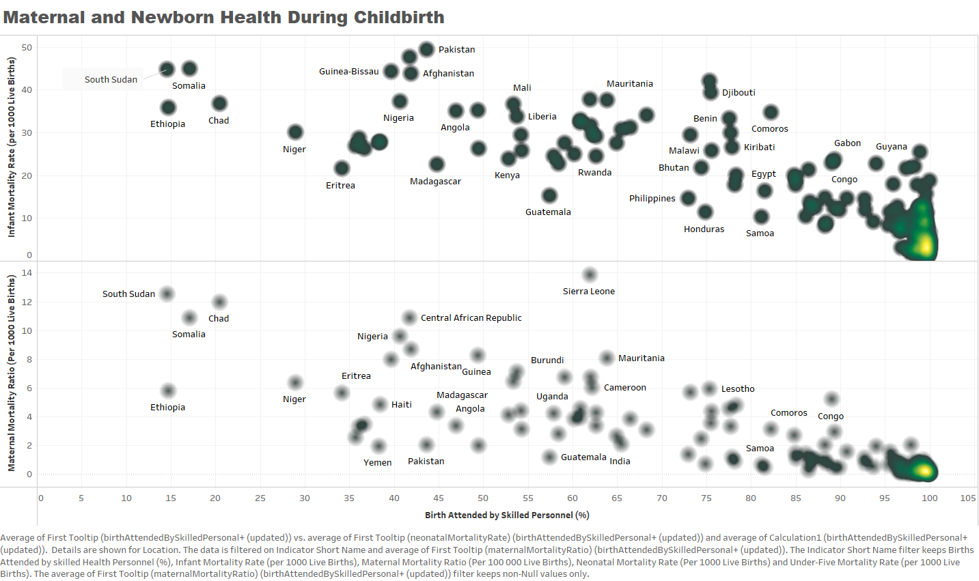

Slide 21
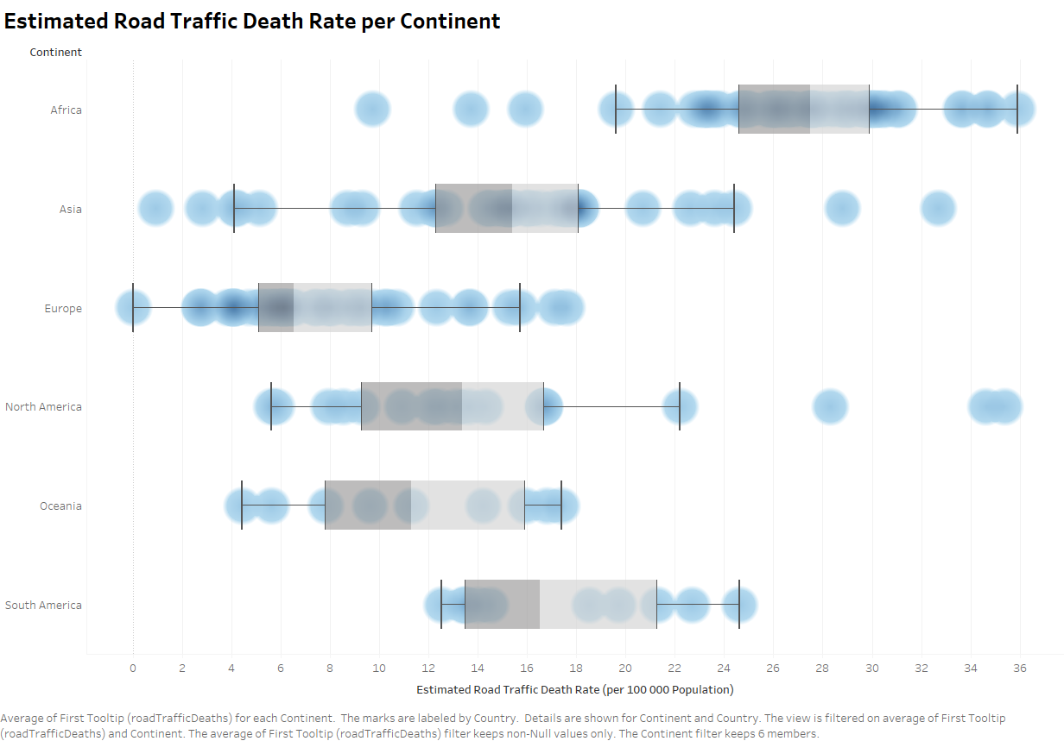

Slide 22
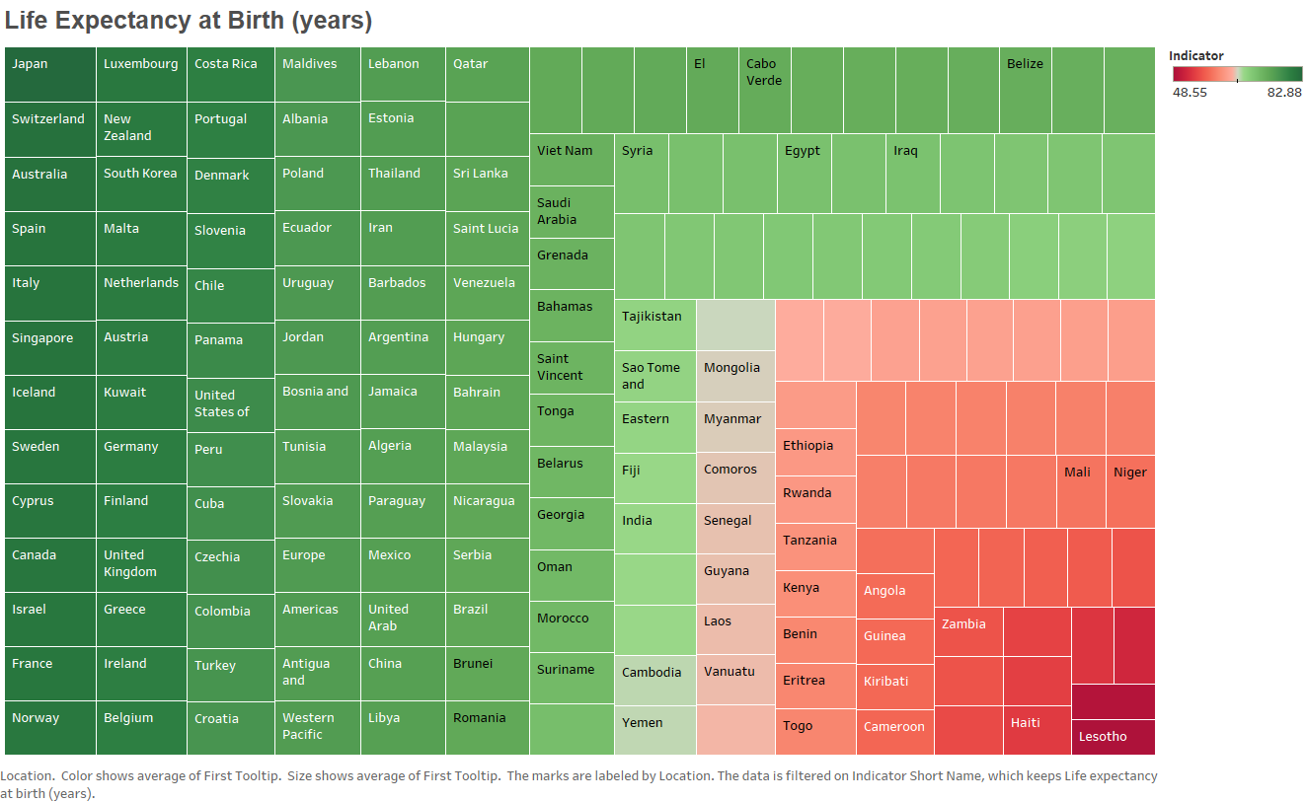

Slide 23
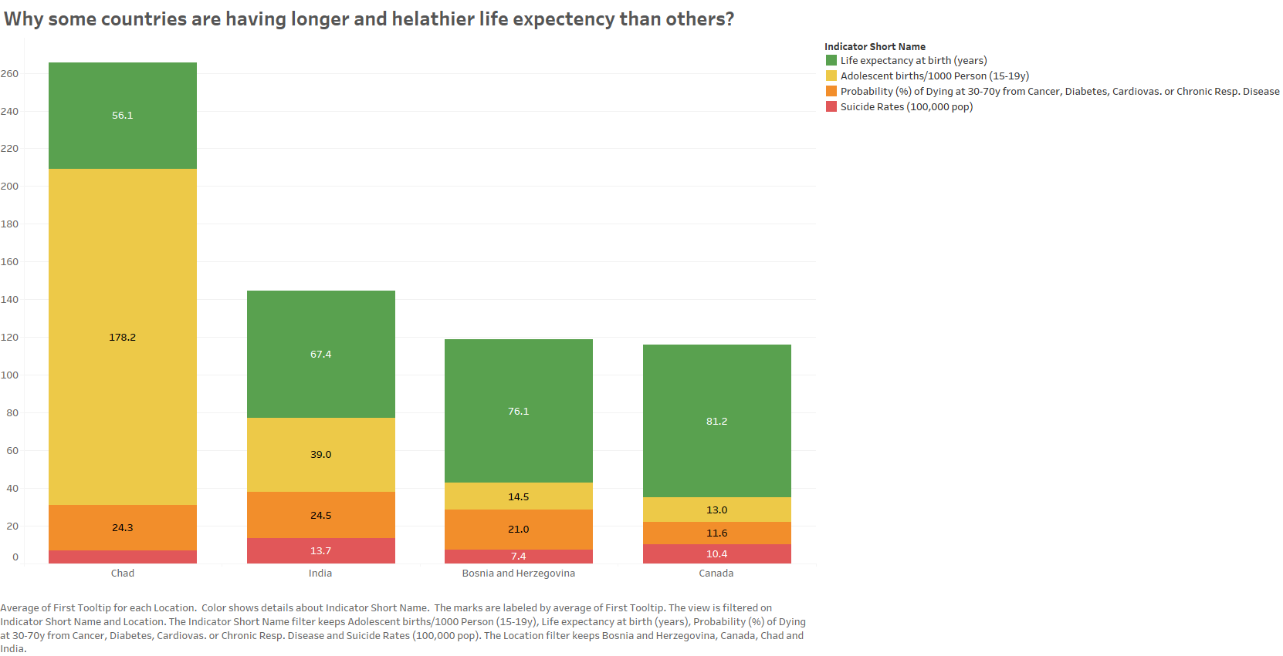

Slide 24
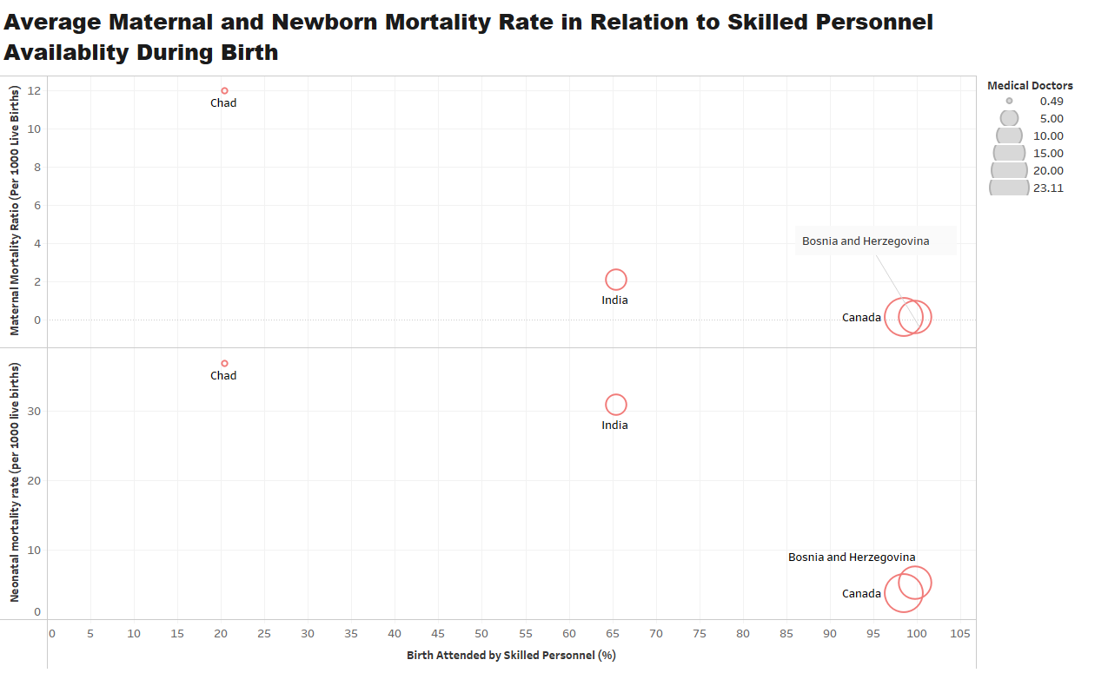

Slide 25
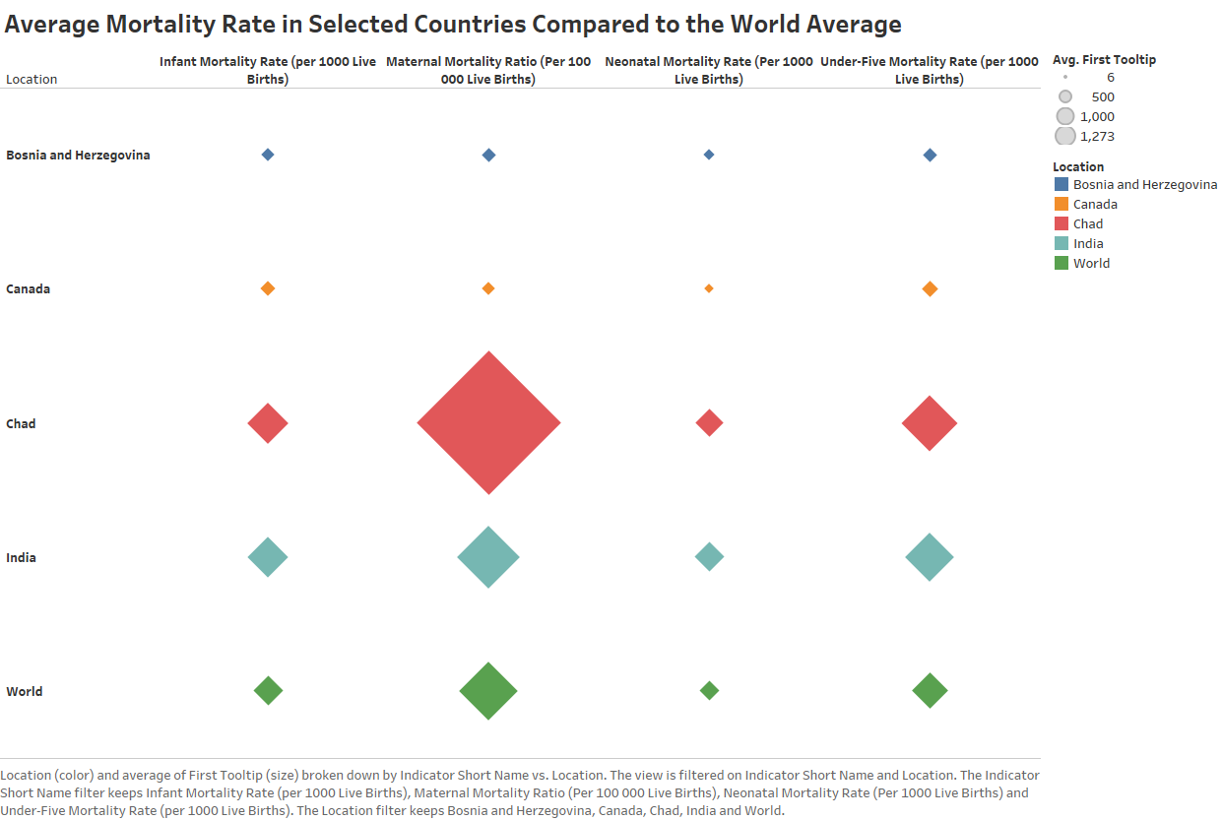

Slide 26
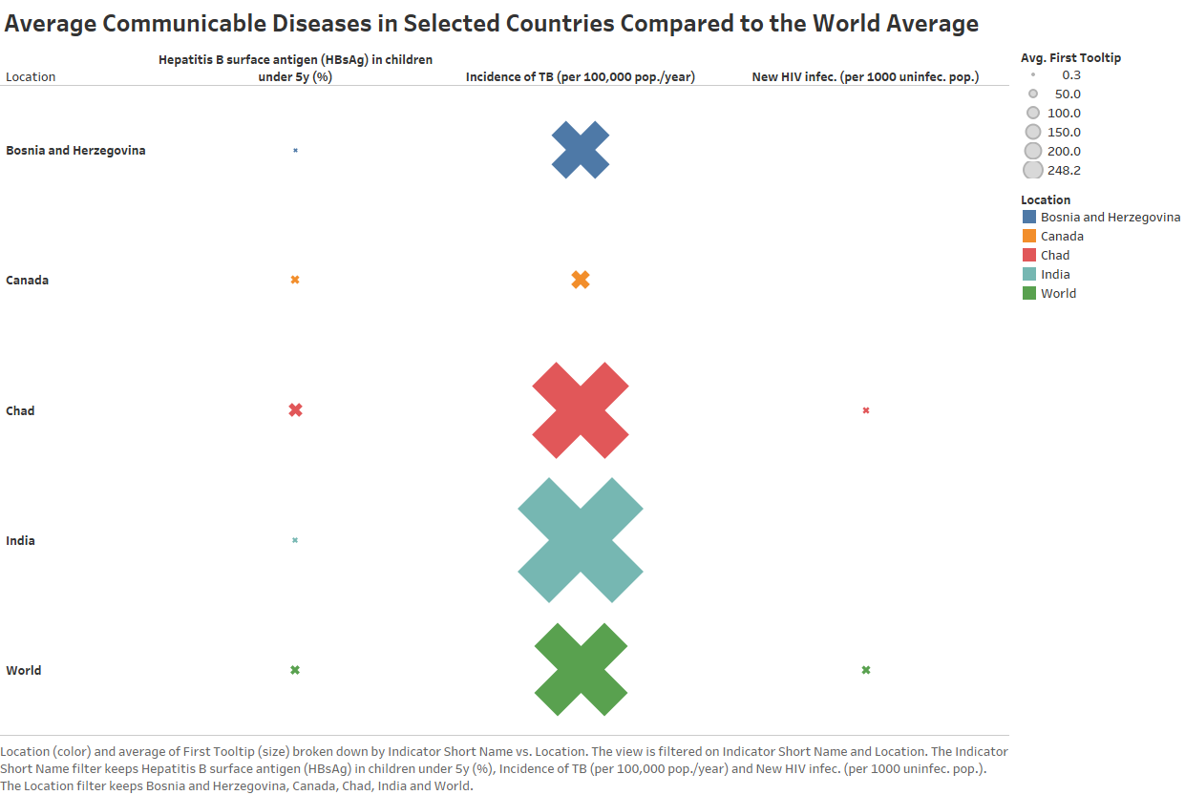

Slide 27
TOBACCO USE
Information for the team. Not intended for the presentation to be submitted.
Tobacco Indicator is age-standardized i.e. mathematically adjusted to allow populations to be compared when age profiles of populations are different.
Only age 15 years-old and older is considered.
The indicator is a percent of population per country per gender per year.
The “both sexes” in the dimension is the weighted average of the percent of the gender based on gender population for a given year.

Slide 28
THANK YOU
#WEAREHST

